Slide 1
CATCHING FRAUD
Revolut Hometask-2

Slide 2
PURPOSE
Based on an unusual observation, noticed by financial crime team, the aim is to investigate the possibility of fraudulent transactions using the relevant data regarding these international monetary transactions.

Slide 3
Objective 1
Examining the given SQL query

Slide 4
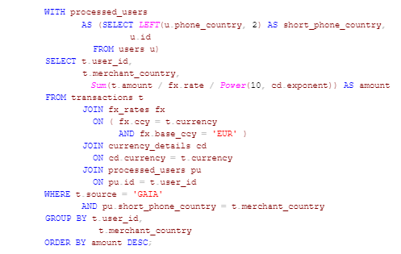
THE QUERY

Slide 5
QUERY PROCESSING: INNER JOINS
users (u)
fx_rates (fx)
processed users (pu)
base_ccy
Inner join
rate
Inner join
ccy
id
phone_country
(base_ccy = ‘EUR’)
transactions (t)
Inner join
user_id
source
Currency
amount
merchant_country
currency_details (cd)
Currency
exponent

Slide 6
QUERY PROCESSING: CONDITIONS
In the previous slide we have joined three different tables i.e fx_rate, processed_users, currency_details to the table transactions. Now, out of all the transactions only certain transactions were chosen based on the conditions described below -
Source of transaction must be ‘GAIA’.
short_phone_country in processed_users table, which is equivalent to the first two characters in phone_country in the users table, must be equal to the merchant_country of the transaction.

Slide 7
QUERY PROCESSING: TOTAL AMOUNT
After applying the condition and eliminating the unwanted transactions, the resulting table has limited rows now. From the resulting table, the query converts the amount used in each transaction into ‘Euro’ using the following equation -
amount = t.amount / fx.rate / Power(10, cd.exponent)
For every unique pair of user_id and merchant_country, there may be more than one transactions implying more than one amounts. All those amounts are summed up to calculate the net amount transacted by an individual.

Slide 8
QUERY PROCESSING: RESULT
After calculating the net amount, the query finally generates the output table which has three columns i.e. user_id, merchant_country and the net amount calculated for the pair sorted in the descending order of the amount.
Result
Sum( )
= net amount in ‘EURO’
t.user_id
t.merchant_country
t.amount
fx.rate
Power (10, )
cd.exponent

Slide 9
CONCLUSION
The aim of the query was to analyze and compare total amount of transaction made by every individual from the source ‘GAIA’.

Slide 10
WILL THIS QUERY WORK?
After analyzing the working of the query, it is found that it has some critical issues which would hinder the working of query in the expected manner.

Slide 11
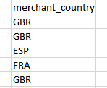
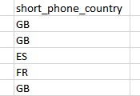
MISMATCH OF PHONE COUNTRY
pu.short_phone_country = t.merchant_country
The condition mentioned above is the second condition of WHERE in the SQL query. Every element in ‘short_phone_country’ column in the ‘processed_user’ will not have more than two characters but the format of ‘merchant_country’ in the ‘transactions’ is such that it could always have more than two characters.
This will lead to the mismatch of the elements. For the above condition to work we have to strip the elements of merchant_country column so that only first two characters are left.

Slide 12
CURRENCY COMPARISON
( fx.ccy = t.currency AND fx.base_ccy = 'EUR' )
The condition mentioned above is the condition of inner join between the tables ‘transactions’ and ‘fx_rates’. When the elements in ‘base_ccy’ column will have value ‘EUR’ then no element in ‘ccy’ column will have value ‘EUR’. This implies that when t.currency will be equal to ‘EUR’ then there is no corresponding row representing fx rates for that (which should ideally be ‘1’) which will lead to either null or error result.

Slide 13
ANSWER
The query will work fine if the two previously stated issues are taken care of.

Slide 14
Objective 2
Writing a SQL query

Slide 15
AIM
To write a query to identify users whose first transaction was a successful card payment over $10 USD equivalent.

Slide 16
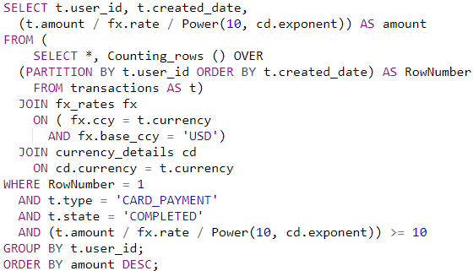
SOLUTION

Slide 17
Objective 3
Finding fraudsters

Slide 18
INCENTIVE
The aim is to find out likely fraudsters from a set of data related to international transactions made across a long time period with the help of a given set of known fraudsters.

Slide 19
INITIALIZATION
The prediction of likely fraudsters will start with analysing the given data. The given data has two necessary tables -
transactions.csv - record of all the transactions made in past several years
fraudsters.csv - list of all the identified fraudsters
The first likely step is the outer join of these two tables to merge them into one table for easy observation and manipulation. The final table is named as ‘fraud_transactions’.

Slide 20
OUTER JOIN
fraud_transactions
fraudsters
Outer join
user_id
transactions
Currency
amount
merchant_country
USER_ID
source

Slide 21
FINDING UNUSUAL BEHAVIOUR
The hypothesis is the fact that there must some similarity between identified and unidentified fraudsters making the fraud transactions. Therefore to identify the fraudsters from rest of the people we must look for any unusual trend followed by the identified fraudsters which rest of the people do not follow.
After the outer join, fraud_transactions table was used for the analysis of any unusual behaviour. The next slides presents all the unusual trends obtained while the thorough analysis of the data.

Slide 22
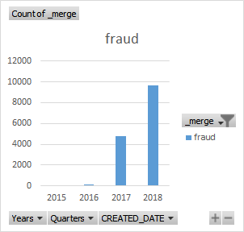
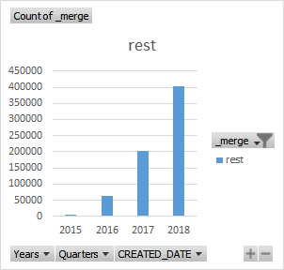
TRANSACTIONS COUNT VS YEARS

Slide 23
TRANSACTIONS COUNT VS YEARS
From the graph we can observe that almost every fraudulent transaction occurred in the year 2017 and 2018. Therefore, all the trends plotted in the upcoming slides is filtered by the year 2017 and 2018.

Slide 24
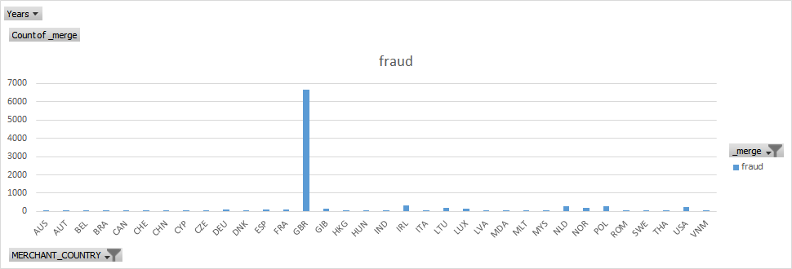
TRANSACTIONS COUNT VS MERCHANT COUNTRY

Slide 25
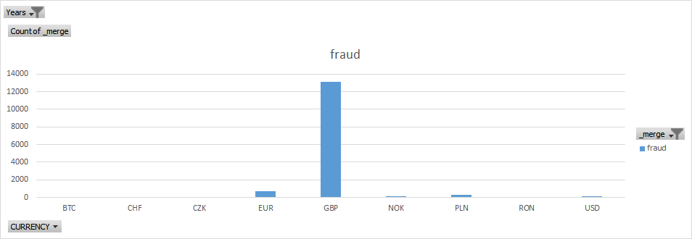
TRANSACTIONS COUNT VS CURRENCY

Slide 26
TRANSACTIONS COUNT VS MERCHANT COUNTRY AND CURRENCY
From the chart, we have seen that most of the fraudulent transactions were from the country ‘GBR’ which has the currency ‘GBP’. Therefore, to identify potential new fraudsters we will focus on the country ‘GBR’ and currency ‘GBP’. All the trends in the upcoming slides are filtered by the merchant_country ‘GBR’ and currency ‘GBP’.

Slide 27
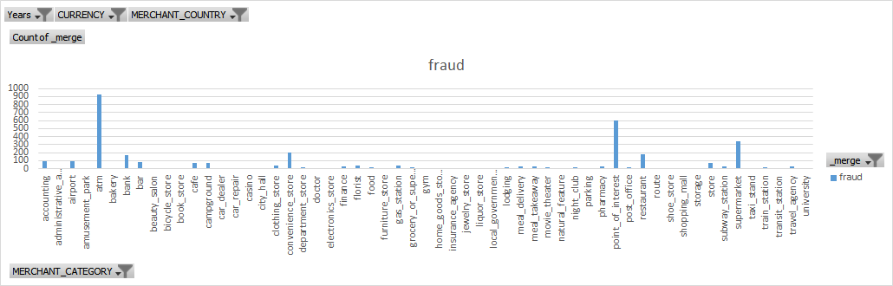
TRANSACTIONS COUNT VS MERCHANT CATEGORY

Slide 28
TRANSACTIONS COUNT VS MERCHANT CATEGORY
From the chart, we can see that atm is the most frequent place for fraudulent transactions Therefore, to better analyze the fraudster’s data the further trends were plotted only for ‘atm’.

Slide 29
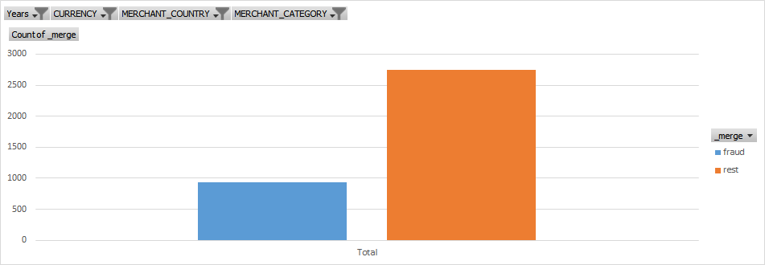
TRANSACTIONS COUNT AFTER APPLYING FILTERS

Slide 30
TRANSACTIONS COUNT AFTER APPLYING FILTERS
In the previous graph we have compared the count of fraudulent transactions after applying the filters mentioned in the previous slides. Those filters are also listed below -
Year - 2017 and 2018
merchant_country - GBR
currency - ‘GBP’
merchant_category - atm
We can see that the count of fraudulent transactions is very comparable with the rest count. Now we will see how the count varies with ‘amount of transaction’ with these filters.

Slide 31
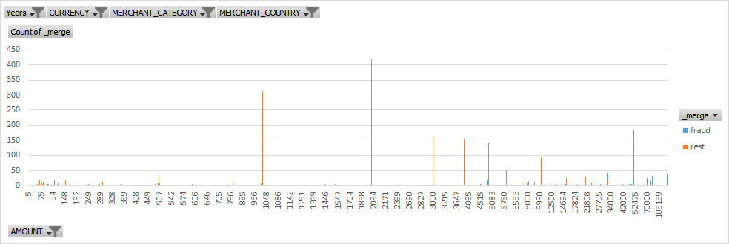
TRANSACTION COUNT VS AMOUNT

Slide 32
TRANSACTION COUNT VS AMOUNT
The previous chart is very crucial for identifying the pattern used by the fraudsters in their transactions. We can observe that certain transaction amounts are used much more frequently by fraudsters than by the rest people. Majority of these amounts are listed in the following array -
[ 100, 25000, 30000, 40000, 50000, 70000, 80000, 288900 ]
Now, we will also use this amount filter and once again analyze the merchant_category distribution which was primarily ‘atm’ before.

Slide 33
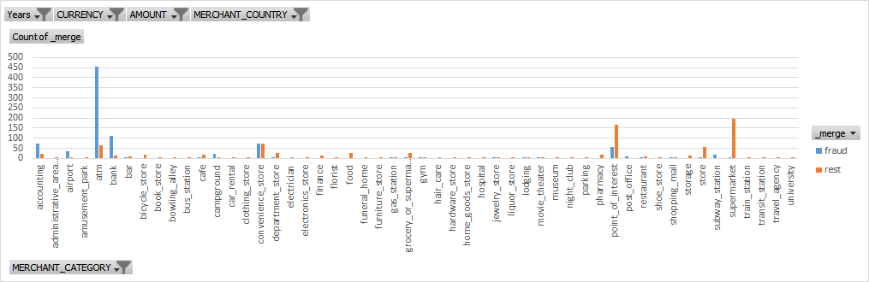
TRANSACTIONS COUNT VS MERCHANT CATEGORY

Slide 34
TRANSACTIONS COUNT VS MERCHANT CATEGORY
We can now see that, not only the atm plays an important role in fraudulent transactions but ‘bank’ also plays a significant role in it as its relative count of fraudulent transactions is also very high.
Therefore, the filter has been updated from ‘atm’ to ‘atm’ and ‘bank’.

Slide 35
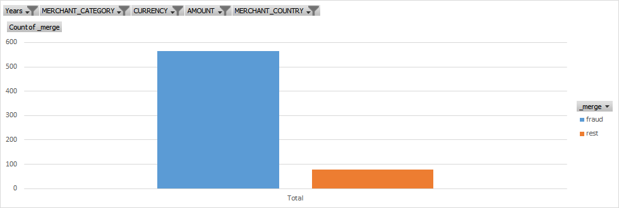
TRANSACTIONS COUNT WITH THE NEW FILTERS

Slide 36
TRANSACTIONS COUNT WITH THE NEW FILTERS
In the previous chart, we can observe that under the given circumstances the count of fraudulent transactions is very high than the count of rest transactions. It is highly probable that any transaction made in the rest transactions category is fraudulent. Therefore, user ids of all the rest transaction were obtained and the top 5 frequent transactions were reported.

Slide 37
ANSWER
USER ID | Count of transactions
f590dcd7-b3b7-493b-9a1f-210fc319485d | 9
50552988-e421-4a57-ba08-2f7f9dc6cae4 | 7
ca027a38-c6eb-4f66-8649-000948986833 | 4
01a29ba5-4c7d-4da7-aa56-59138d4a0859 | 4
79638a4e-e6df-43ae-8d82-14832364544b | 3

